Slide 1



External validation of prognostic models in critical care: a cautionary tale from covid-19 pneumonitis.
Sebastian Bate, Victoria Stokes, Hannah Greenlee, Kwee Yen Goh, Graham Whiting, Gareth Kitchen, Glen P Martin, Alexander J Parker, and Anthony Wilson, on behalf of the MRI Critical Care Data Group
/sebastianbate
@sebastianbate
sgbstats

Slide 2
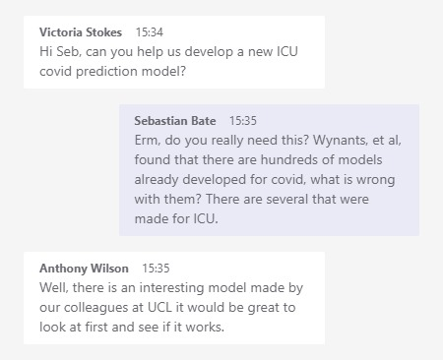
Back in the deep, dark days of March 2021….
Wynants L, Van Calster B, Collins GS, Riley RD, Heinze G, Schuit E, et al. Prediction models for diagnosis and prognosis of covid-19: systematic review and critical appraisal. bmj. 2020;369.
Arina P, Baso B, Moro V, Patel H, Ambler G. Discriminating between CPAP success and failure in COVID-19 patients with severe respiratory failure. Intensive care medicine. 2021;47(2):237-9.

Slide 3
Stokes et al, 2022
Arina et al, used CRP and BNP in a model for CPAP failure (death/intubation) vs success.
External validation in Manchester using two cohorts: patients up to 15/6/20 (when dexamethasone was introduced as routine) and all patients to 31/10/21
Model works well among patients pre-dexamethesone (C=0.839) but poorly after (C=0.613)
Stokes V, Goh KY, Whiting G, Bate S, Greenlee H, Wilson A, et al. External validation of a prediction model for CPAP failure in COVID-19 patients with severe pneumonitis. Critical Care. 2022;26(1):293.

Slide 4
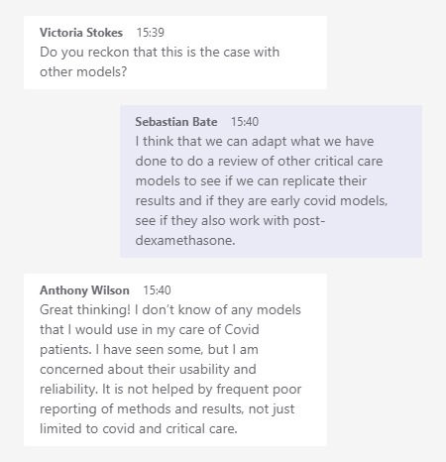
Some months later…
Dhiman P, Ma J, Andaur Navarro CL, Speich B, Bullock G, Damen JA, et al. Methodological conduct of prognostic prediction models developed using machine learning in oncology: a systematic review. BMC medical research methodology. 2022;22(1):1-16.
Moons KG, Altman DG, Reitsma JB, Ioannidis JP, Macaskill P, Steyerberg EW, et al. Transparent Reporting of a multivariable prediction model for Individual Prognosis or Diagnosis (TRIPOD): explanation and elaboration. Annals of internal medicine. 2015;162(1):W1-W73.
Cox EGM, Wiersema R, Eck RJ, Kaufmann T, Granholm A, Vaara ST, et al. External Validation of Mortality Prediction Models for Critical Illness Reveals Preserved Discrimination but Poor Calibration. Critical care medicine. 2023;51(1):80-90.

Slide 5
Where is the gap?
There have been external validations of Covid-19 prediction models, but there is yet to be one that specifically focusses on models developed in ICUs rather than general wards.
de Jong VM, Rousset RZ, Antonio-Villa NE, Buenen AG, Van Calster B, Bello-Chavolla OY, et al. Clinical prediction models for mortality in patients with covid-19: external validation and individual participant data meta-analysis. bmj. 2022;378.
Gupta RK, Marks M, Samuels THA, Luintel A, Rampling T, Chowdhury H, et al. Systematic evaluation and external validation of 22 prognostic models among hospitalised adults with COVID-19: an observational cohort study. European Respiratory Journal. 2020;56(6):2003498.
Paul MELvD, Noortje Z, Sander MJvK, Aimée EMJHL, Renée AGB, Bart S, et al. Performance of prediction models for short-term outcome in COVID-19 patients in the emergency department: a retrospective study. Annals of medicine (Helsinki). 2021;53(1):402-9.
Wickstrøm KE, Vitelli V, Carr E, Holten AR, Bendayan R, Reiner AH, et al. Regional performance variation in external validation of four prediction models for severity of COVID-19 at hospital admission: An observational multi-centre cohort study. PloS one. 2021;16(8):e0255748-e.
Meijs DAM, van Kuijk SMJ, Wynants L, Stessel B, Mehagnoul-Schipper J, Hana A, et al. Predicting COVID-19 prognosis in the ICU remained challenging: external validation in a multinational regional cohort. Journal of clinical epidemiology. 2022;152:257-68.

Slide 6
Aims
Are published ICU multivariable prediction models sufficiently described to allow new predictions to be generated, and performance compared to the original publication?
Do these models use parameters that are routinely recorded in most ICUs?
Is the performance (by discrimination and/or calibration) of these models replicable in patients from a similar period to when the model was developed, either pre- or post-the introduction of dexamethasone?
Is the performance (by discrimination and/or calibration) of these models replicable using patients for the duration of the pandemic?

Slide 7
Methods
Lit Search
Wynants, PubMed, reverse citation
IC/EC: models where the study population used to develop the original model was
Adults (aged over 16 years) admitted to the ICU with a diagnosis of COVID pneumonitis
Required at least two predictor variables, and which were measured within 24 hours of, or prior to, ICU admission or 24 hours prior to onset of invasive mechanical ventilation (IMV), depending on the model, or demographic data.
The endpoint was death at any point, need for IMV, or length of stay in ICU.

Slide 8
Methods
Data extraction
Assess whether predictions can be generated based off what was published
Cross reference variables against what was available in the EPR
Those that qualify:
Remake the model using the IC/EC of the original publication
Check discrimination using the same test that the original paper used and calibration (if possible)

Slide 9
Data
Manchester Royal Infirmary ICU EPR
1st March 2020 to 28th February 2022
Incidental covid and national data opt-out excluded
Ethical approval 21/HRA/3518

Slide 10
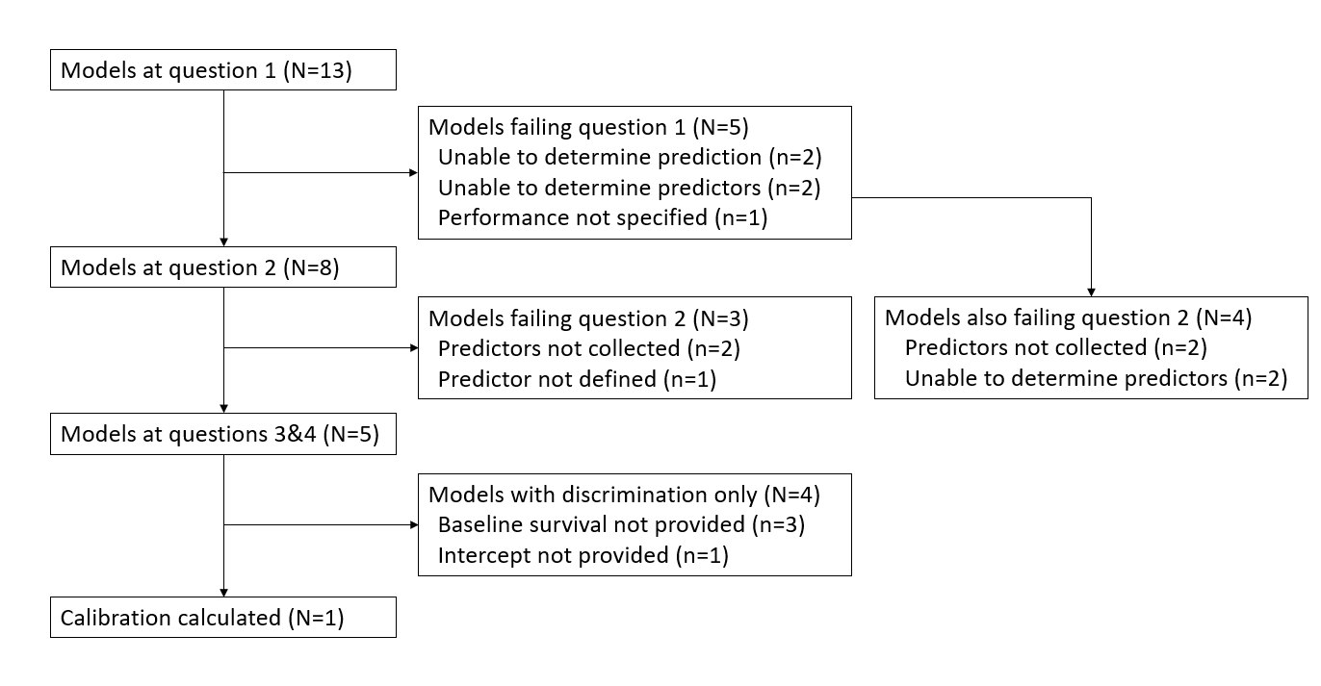
Results
Notes:
Common issues were xgBoost models or other DL where there substantial incomplete recording; predictors not collected (Clotting factors etc) or questionnaires. There was one that had ‘chest tightness’ as a factor. Poor quality reporting

Slide 11
 | Endpoint | Predictors used | Development cohort size | Model Type | Original publication |  | Pre-dexamethasone era |  | All patients
Reference |  |  |  |  | N | Reported C | N | C | N | C
Arina | IMV or death | CRP, BNP | 93 | Logistic regression | 93 | 0.804 (0.728 - 0.880) | 27 | 0.793 (0.618-0.968) | 103 | 0.596 (0.482-0.710)
Cao | Death | Urea, hs-CRP | 77 | Logistic regression | 77 | 0.857 (0.77–0.94) | 22 | 0.567 (0.321-0.813) | 141 | 0.558 (0.460-0.655)
Leoni, Lombardelli | Death censored at 28 days | Age, Obesity, Procalcitonin, SOFA, PaO₂/FiO­₂ | 229 | Cox regression | 229 | 0.821 (0.766–0.876) | 33 | 0.605 (0.471-0.739) | 204 | 0.564 (0.506-0.622)
Leoni, Moschini | Death censored 28 days | Mnutric, hs-CRP, Neutrophils | 98 | Cox regression | 98 | 0.720 (0.67-0.79) | 34 | 0.560 (0.428-0.692) | 201 | 0.546 (0.484-0.608)
Moisa | Death censored at 28 days | Age, NLR, SOFA | 425 | Cox regression | 425 | 0.697 (0.755–0.833) | 53 | 0.672 (0.574-0.770) | 291 | 0.686 (0.640-0.732)
BNP, N-terminal pro B-type natriuretic peptide; C, concordance statistic (hs-)CRP, (high sensitivity)y C-reactive protein; IMV, invasive mechanical ventilation; Mnutric, modified nutritional risk in critically ill; NLR, neutrophil-to-lymphocyte ratio; SOFA, serial organ failure assessment.

Slide 12
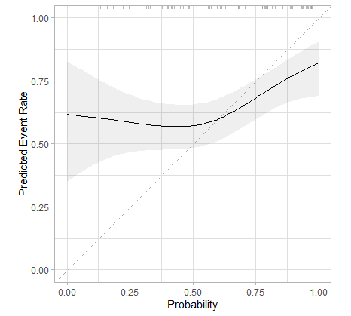
Calibration
Only one model could be calibrated (Arina)

Slide 13
Key points
In ICU, where the pressure on beds is high and the decisions around such resource use so important, clinical prediction models are particularly appealing and yet demonstrably unhelpful at present.
On the basis of our findings, we urge bedside intensivists to exercise caution before using any of the examined models to support clinical decision making.
Don’t go round making prediction models because you are bored
Use TRIPOD to at least give us a fighting chance of being able to validate it

Slide 14
My thanks to my colleagues for their contributions and for the support in getting it her: Tori, Anthony, Cath, Hannah, Kaithlyn, Graham, Glenn and Alex
Our thanks to MFT staff for their assistance in data collection
This work was funded-in-kind by MFT
References: github.com/sgbstats/NIHRstats23

